Slide 1
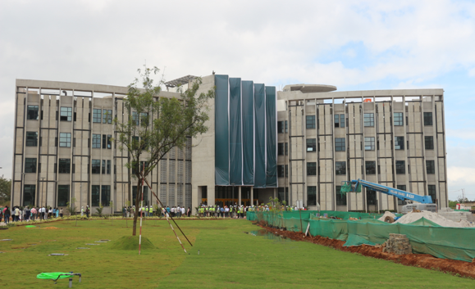
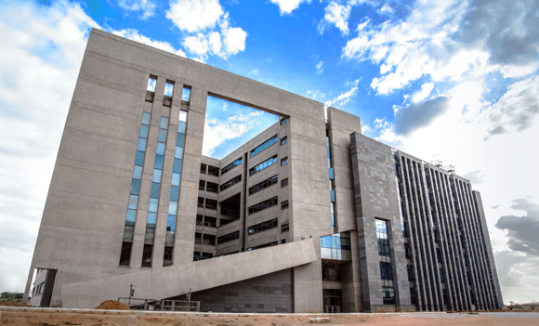
Biomedical Engineering
Where the boundaries between disciplines fade !
PhD Admissions Brochure
(2024)

Slide 2
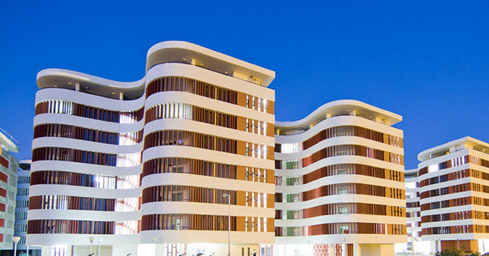
PhD Admissions @ Biomedical Engineering
BME@IITH
The Department of Biomedical engineering at Indian Institute of Technology Hyderabad (IITH) welcomes applications from suitably qualified and highly motivated students, willing to pursue research in the following research areas.
Biomedical Imaging
Biomicrofluidics & Biomechanics
Regenerative Medicine & Stem Cell Research
Nano Medicine & Regenerative Medicine
Computational Neurosciences
Bio-nanotechnology & Nanomedicine
Biofabrication & Tissue Engineering
Neurotechnology & Neuroscience
Computational Systems Biology and Biomechanics
Ultrasound Imaging & Therapeutics
Biomedical Informatics & Healthcare
Magnetic Resonance Imaging
IITH Hostels

Slide 3
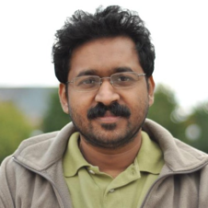
Biomedical imaging
BME@IITH
Dr. Renu John
Novel non-invasive bio-imaging techniques
Coherence imaging and microscopy techniques
Molecular contrast agents and Targeted molecular imaging
Nanoparticles
Targeted drug delivery and Bio-photonics applications
Single-mode fiber
Fixed mirror
SLD light Source
50-50 fiber coupler
Reference arm
Transverse scanning galvos
Spectrometer
(Line-scan CCD)
Lab website
Achromat lens
Data acquisition
Programmable power supply
Z
Computer
x
Sample

Slide 4
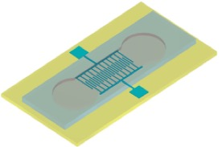
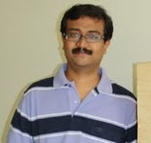
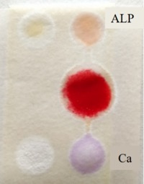
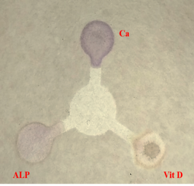
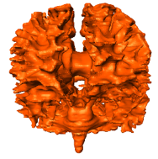
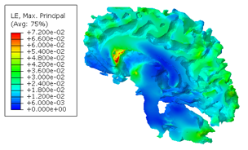
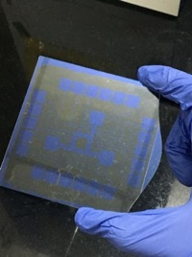
Biomicrofluidics and Biomechanics
BME@IITH
Dr. Harikrishnan Narayanan Unni
Microfluidics and Lab on Chip for Bioengineering
Lab on Chip for protein aggregation modelling
Computational Biophysics and Systems Biology
Computational Biomechanics
DEP Microfluidic Device
White matter Strain distribution – impact loading – FEM study
muPADs- Paper analytic devices
EWOD Electrode patterns

Slide 5
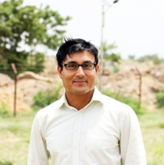
Regenerative Medicine & Stem Cell (RMS)
BME@IITH
Dr. Subha Narayan Rath
Evaluation of in vitro stem cell-biomaterial interactions using micropatterning and nanofibers
In vivo like bioreactor use for tissue development
Molecular biological analysis of angiogenesis, osteogenesis, and evaluation of diabetic cell therapy
Application of 3D-cell printing for regeneration of vascularized and osteo-chondral tissues.
2. Bio-mimicking smart designed biomaterials
1. Designing devices for novel application in diabetes, musculo-skeletal diseases
Lab website
3. 3D bio-printing of tissues using patient-derived stem cells
4. Microfluidic chips simulating physiology stem cell culture and drug testing

Slide 6
Nano Medicine & Regenerative Medicine (eNARM Lab)
BME@IITH
Regenerative Medicine:
Heart Tissue Regeneration
Chronic Wound Healing
Cartilage Regeneration
Periodontal Regeneration
Stem Cell and Delivery
3D Organoid for Drug/disease model
Nanomedicine
Cancer Stem Cell Therapeutics
Immunoengineering and Therapy
Affordable Vaccine Platform (Microneedle)
Protein Delivery and Therapeutics
mRNA Delivery and Therapeutics
Cell-Materials Interactions
Nanotoxicity
Stem Cell-Biomaterials Interaction

Slide 7
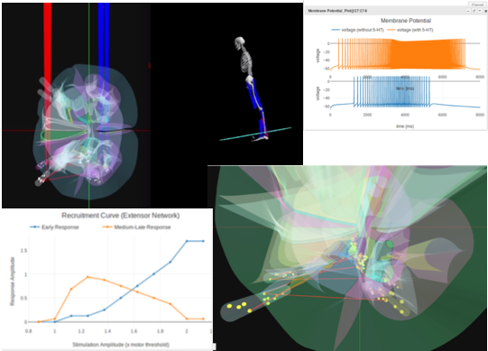
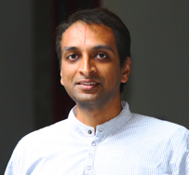
Computational Neurosciences
BME@IITH
Dr. Mohan Raghavan
Spine Labs is focused on developing platform technologies around Neural simulation of human motor circuitry and afferent fibres. We use these simulation based technologies for advancing
Clinical Practice & Medical device development
Robotics and Neuromorphic technologies
Basic science and Education
Lab website
Note: Candidates with a background in programming, mechanical engg or any other quantitative sciences are preferred!!

Slide 8
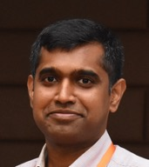
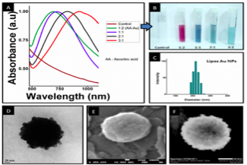
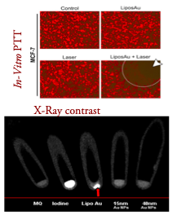
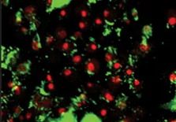
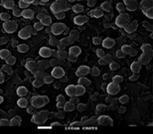
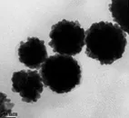
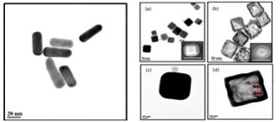
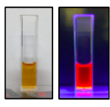
Bio-nanotechnology and Nanomedicine
BME@IITH
Dr. Aravind Kumar Rengan
Cancer Nanotechnology
Nanotoxicology
Nano-Biomaterials
Triggered/Targeted Drug Delivery
Anti-microbial nano-therapeutics
Theranostic applications
Targeted Nano Theranostics
Lab website
Control
NPs Treated

Slide 9
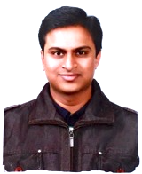
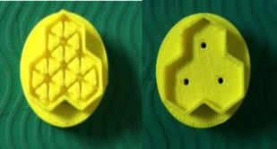
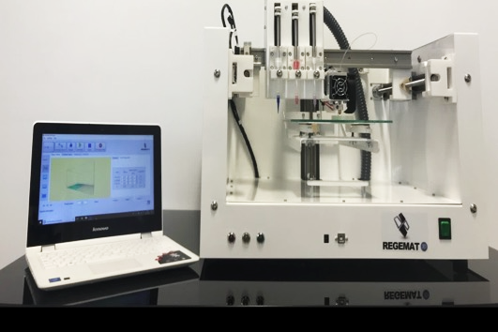
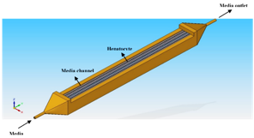
Biofabrication and Tissue Engineering
BME@IITH
Dr. Falguni Pati
3D bioprinting of tissue/organ constructs for tissue engineering and regenerative medicine
In vitro tissue/organ models for fundamental study and drug/toxicity testing
Development of novel bioprintable biomaterial and bioink formulation
3D cell and tissue printing for personalized medicine
3D printed customized and personalized orthosis and prosthesis
Lab website
Tissue/Organ-derived bioink for 3D bioprinting
CAD Model and 3D printed structures of next generation miniature bioreactor
3D Bioprinting facility at Biofab lab

Slide 10
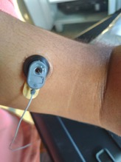
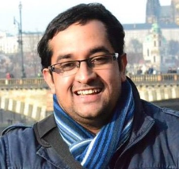
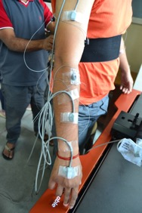
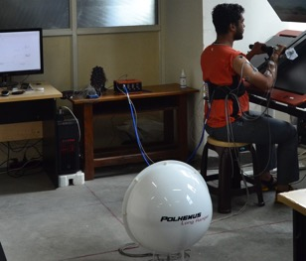
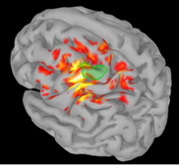
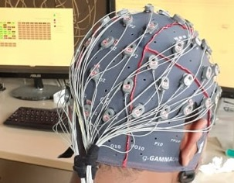
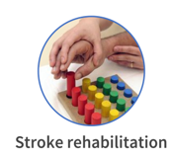
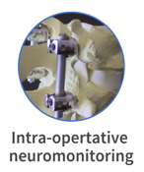
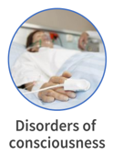
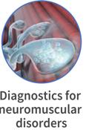
Neurotechnology and Neuroscience
BME@IITH
Dr. Kousik Sarathy Sridharan
Neuroimaging of the brain & peripheral electrophysiology
Invasive and non-invasive neuromodulation for neurological and psychiatric disorders
Intraoperative Neuromonitoring support systems
Lab website

Slide 11
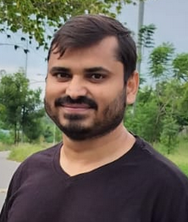
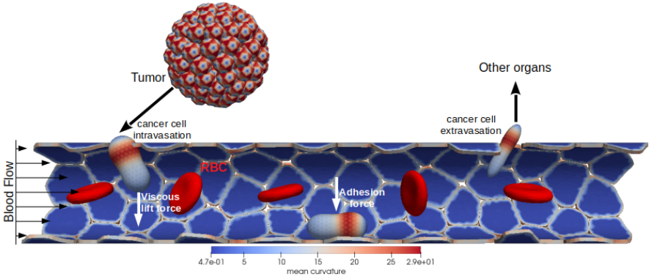
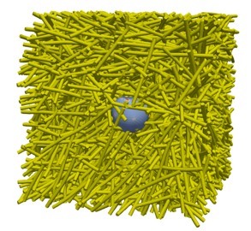
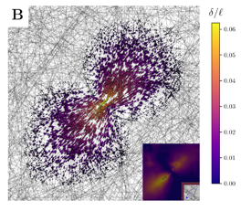
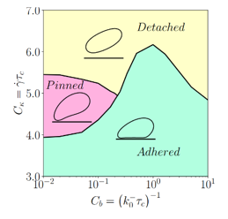
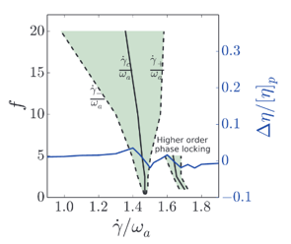
Computational Bioengineering
BME@IITH
Dr. Mohd Suhail Rizvi
We utilize mathematical and computational approaches to study
1. mechanics of cancer metastasis
2. cell-ECM interactions
3. computational frameworks for drug delivery
4. in silico disease models
Cancer metastasis
Active matter
Cell-ECM interactions
Bio-hydrodynamics

Slide 12
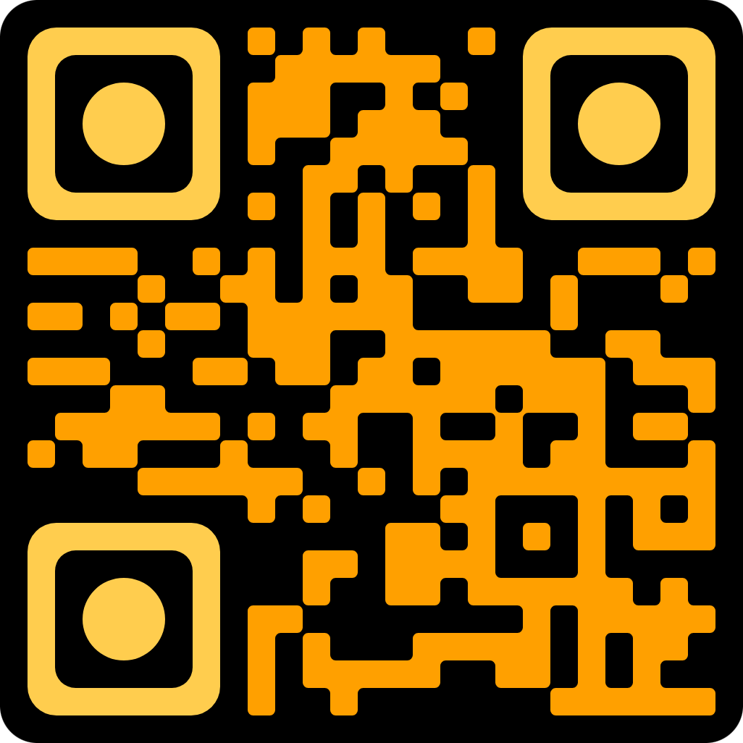
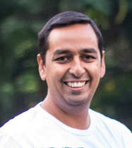
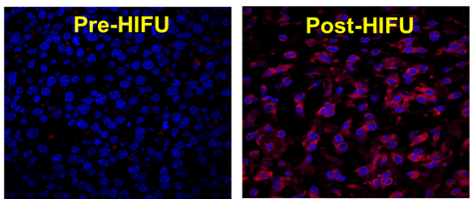
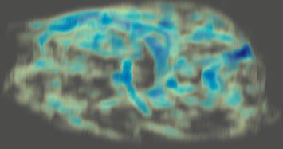
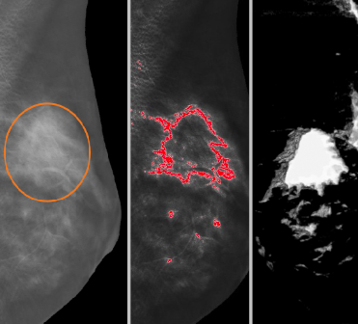
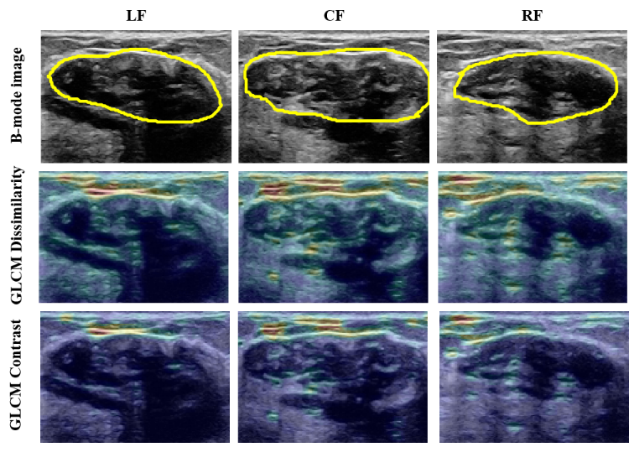
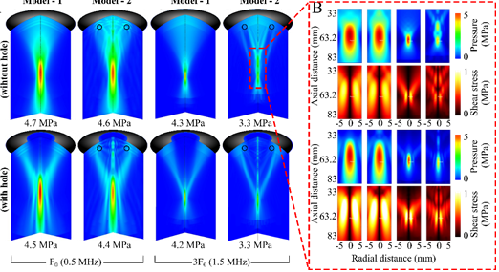
Ultrasound Imaging & Therapeutics
BME@IITH
Dr. Avinash Eranki
My lab is focused on developing:
AI and ML for Ultrasound
Image-guided Therapeutic Ultrasound (FUS/HIFU) for solid tumor therapy
Ultrasound-based drug delivery & Liquid Biopsy
MURL.bio
Quantitative Pathology and Acoustics
Quantitative Ultrasound
AI/ML for Ultrasound

Slide 13
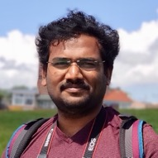
Medical Informatics & Digital Health
BME@IITH
Dr. Nagarajan Ganapathy
My lab is focuses on the solutions for
MInDH
Lab

Slide 14
Magnetic Resonance Imaging
BME@IITH
Dr. Jaladhar Neelavalli
My lab is focused on developing
Novel biomarkers for neurodegenerative diseases and therapy monitoring
Fast and motion-robust MR imaging techniques for fetal imaging
Quantitative MRI methods for body imaging
Building low/ultra low-field MRI systems and developing their clinical applications
SWI of the spine showing calcification
Applied Magnetic Resonance Imaging Sci. & technology lab
AMRIT

Slide 15
Eligibility criteria
BME@IITH
M.Tech./M.E./M.S.(Engineering/Technology)/MSc/MBBS/BDS degree in the respective or allied areas
Candidates with Bachelor’s degree in Engineering/Technology or Master’s degree in Sciences in an allied area and possessing a valid GATE score may also apply
For those who have not yet completed their qualifying examination, marks up to the 7th semester/ 3rd year (for B.Tech students) and 3rd semester/ 1st year for PG students will be considered
Candidates with CSIR-NET-JRF / UGC-NET-JRF award for Research fellowship or equivalent or GATE Qualification are encouraged to apply
Please note that a stringent criteria may be used based on the marks in previous degrees in short-listing candidates to be called for interview.

Slide 16
General information
BME@IITH
Residency requirement is compulsory for external registrants to complete the required course credits (a minimum of four (4) courses) in the first year
Applicants working in reputed R&D Organizations/Laboratories are eligible to apply
Such applicants (a) need to be deputed on leave by the parent organization/department (b) do not require GATE qualification, and (c) will not be paid any assistantship or scholarship by IIT Hyderabad.
Selection process is purely merit based and candidate will be tested in interview
Application fees and details are available on IITH web page (www.iith.ac.in)
Create login id and apply online on IITH website www.iith.ac.in/phdadmissions

