Slide 1
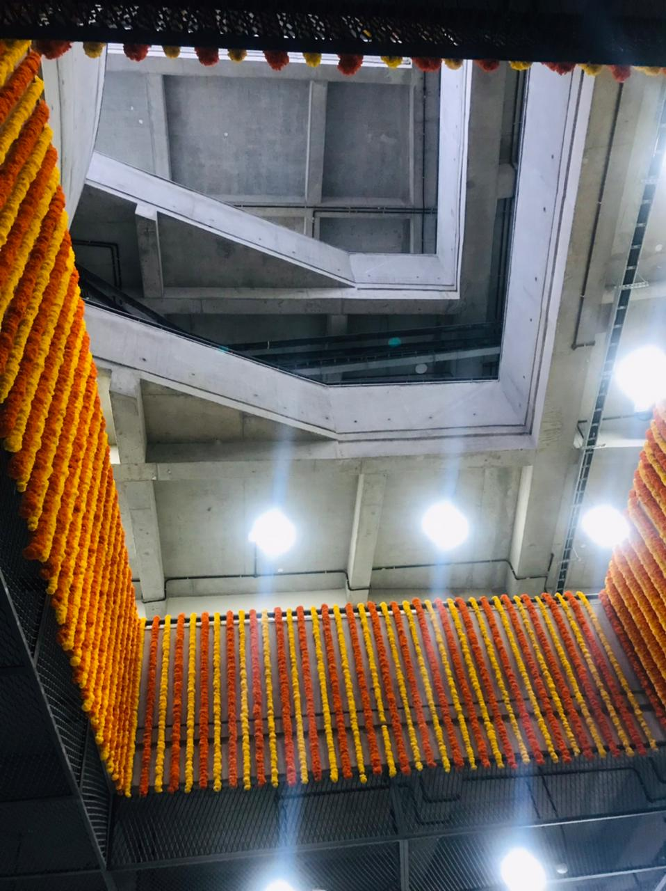
Ph.D. Admissions: October 2024
Materials Science &
​Metallurgical Engineering​
https://msme.iith.ac.in/
​

Slide 2
MSME Ph.D. Programme
The Doctor of Philosophy (Ph.D.) program is for enthusiastic students with strong analytical skills and very good academic backgrounds willing to take up challenging research problems in various areas of Materials Science and Metallurgical Engineering. Research areas include design and development of novel materials for structural and functional applications, development of novel characterization procedures, computational materials science and materials informatics, development of novel processing techniques, metal additive manufacturing, metal joining, electrochemical materials processing, novel semiconductor fabrication, spintronics, plasmonics, multiferroics and so on.
Selection process
Shortlisted candidates will be called for the selection process.
Selection will be conducted based on written test and/or interview.
Contact details
MSME Ph.D. Admissions Committee
Department of Materials Science & Metallurgical Engineering
Email: phd.admissions@msme.iith.ac.in
visit www.iith.ac.in for more information and apply online

Slide 3
MSME
Advanced Alloys and Composites
Functional materials and devices – multiferroics, semiconductors, metamaterials, spintronics, plasmonics
Advanced Materials Characterization
Materials processing
Electrochemical Materials Engineering
Computational Materials Science,
Multiscale modeling,
Materials Informatics
Health care & Bio-Materials
Research areas
Sustainable materials
Nanoscience & Nanotechnology
Energy materials

Slide 4
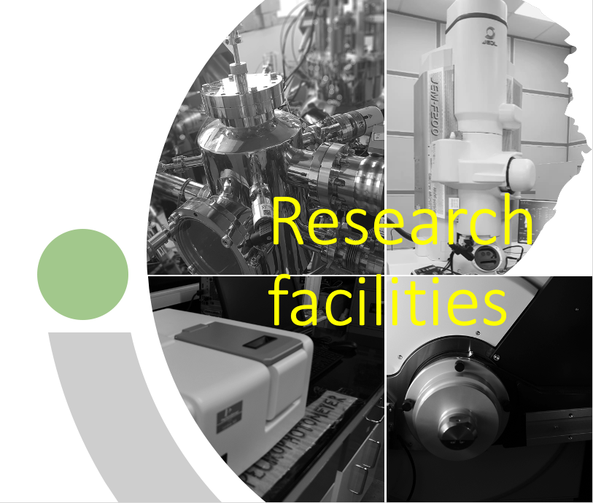
Facilities at MSME
Computational
Materials Synthesis and Processing
Thermo-Calc
DICTRA
TC-Prisma
COMSOL Multiphysics, ANSYS
CrystalMaker Suite
VASP
State-of-the-art GPU clusters
Inhouse NSM Supercomputing facility ParamSeva
MicroSim
Pulse Laser Deposition
E-beam deposition
Planetary Ball mill
Rolling mill
Robotic GTA welding
Uniaxial Compaction Press
Cold-Isostatic Press
Induction-melting furnace
Arc-melting furnace
Electrochemical Workstation
Spin and Dip coater
Sputtering
Hot press
High Temperature Vacuum Furnace
Infra-red heating furnace
Muffle and tube furnaces
Salt-bath furnace
Autoclave Ovens
Incubator shaker
Freeze drier
Bio-safety cabinet
Glove-box
Characterization
Cold FEG-TEM
FEG- SEM with EBSD
Optical Microscopes
FIB
Ion-milling, PIPS
SPM
Surface area and porosity analyser
Powder & thin film XRD
UV visible spectrophotometer
Raman spectrometer
DTA, DSC, TGA, Dilatometer
Universal testing machine (MTS, Instron)
Creep Testing
Hardness Tester
Wear (Pin-on-disk)
Nanoindentor
Electrochemical analyser
Viscometer

Slide 5
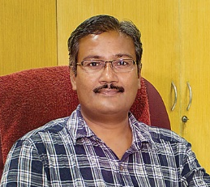
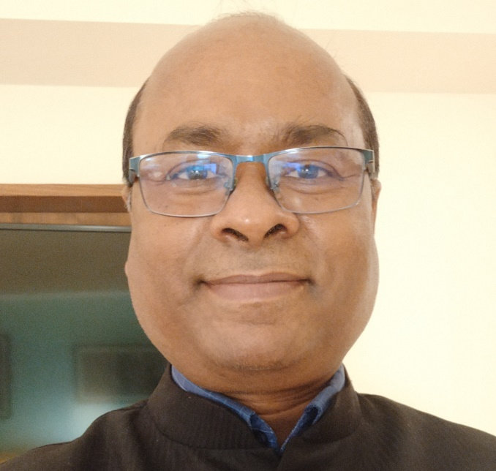
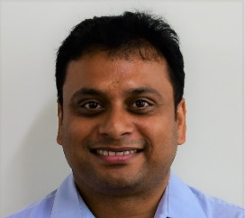
MSME Faculty
Prof. G.D. Janaki Ram
Welding Additive manufacturing
Prof. B. S. Murty
Nanocrystalline materials
Thermodynamics & kinetics of phase transformations
High entropy alloys
Bulk metallic glasses
TEM and atom probe tomography
jram@msme.iith.ac.in +91 (40) 2301 6565
Prof. Bharat B. Panigrahi
Powder Metallurgy & Sintering Mechanisms High Entropy Alloys, MAX Phases and MXene, Advanced ceramics & composites Microstructure-Mechanical Properties of Steels Metal Additive Manufacturing, Electro-Spark Coating, Wear & Tribology
bsm@msme.iith.ac.in +91 (40) 2301 6001
Prof. Pinaki P. Bhattacharjee
Design and Development of High Entropy Alloys Development of metallic alloys for advanced and emerging applications Materials processing, microstructure, and crystallographic texture Bulk ultrafine/nanostructured and heterogeneous materials Application of high-resolution Electron Back Scatter Diffraction (EBSD) and Transmission Electron Microscopy (TEM) in materials characterisation. Mechanical properties of materials
bharat@msme.iith.ac.in +91 (40) 2301 6555
Prof. Suhash R. Dey
Electrochemical Materials Processing - Green Hydrogen production, reduction of CO₂ & N₂ - Electrochemical/Microbial Recovery & Recycling of e-wastes (end of life NdBFe permanent magnets, spent Lithium-ion batteries, Silicon PVs) via electrowinning - Electrochemical Iron & Steel Manufacturing - Molten salt electrolysis for new age applications Advanced Multi-Functional Nanostructured Materials/High Entropy Alloys making via Electrodeposition: Combinatorial Alloy Design
pinakib@msme.iith.ac.in +91 (40) 2301 6551
suhash@msme.iith.ac.in +91 (40) 2301 6552

Slide 6
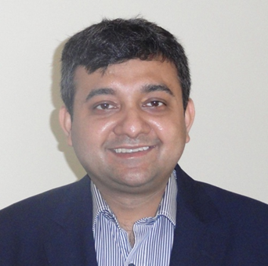
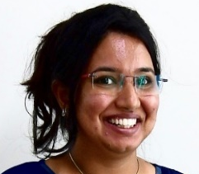
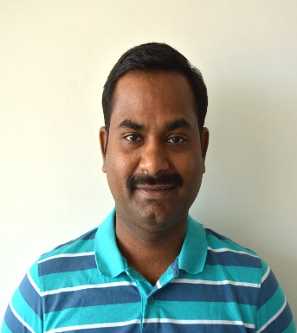
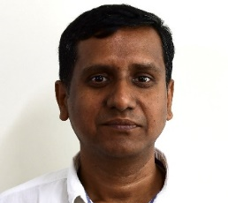
MSME Faculty
Prof. Ranjith Ramadurai
Multiferroic oxide thin films for fundamental science and functional device applications High-k dielectric thin films for CMOS technology and memory device applications Surfaces and Interfaces of oxide heterostructures on silicon and single crystalline oxide substrates Influence of process conditions, strain engineering and interface engineering on domains and domain dynamics of multiferroic thin films utilising scanning probe microscope
Prof. Saswata Bhattacharya
Phase transformations in alloys and oxides Phase-field modelling of microstructural evolution Discrete Dislocation Dynamics Materials Informatics – Inverse Modeling Development of Multiscale Modeling Techniques and Tools for ICME
ranjith@msme.iith.ac.in +91 (40) 2301 6553
Dr. Mudrika Khandelwal
High-performance and functional green composites Liquid crystals and self-assembly Drug Delivery Anti-fouling and anti-microbial materials Depth filters Energy storage and conversion (actuators) Nanofibrous devices, functional textiles
saswata@msme.iith.ac.in
Dr. Atul S. Deshpande
Nanoparticle synthesis and self-assembly, sol-gel processes, templating techniques Novel nanostructured materials for advanced applications, including catalysis, energy storage and superhydrophobic coatings High entropy oxides
mudrika@msme.iith.ac.in
Dr. Subhradeep Chatterjee
Phase Transformations and Microstructure Development Laser and Electron Beam Processing Welding and Surface Treatment Modelling and Simulation (Phase Field/FEM/CVM)
atuldeshpande@msme.iith.ac.in +91 (40) 2301 6554
subhradeep@msme.iith.ac.in +91 (40) 2301 6558

Slide 7
MSME Faculty
Dr. Sairam K. Malladi
In situ characterisation and technique development using MEMS devices (lab on a chip) Applications of in situ and correlative characterisation techniques to understand transformations in materials, Electrochemistry and Corrosion
Dr. Rajesh Korla
Deformation at room temperature Creep and super-plasticity Micro mechanical deformation Molecular dynamic simulations Nano indentation
srkm@msme.iith.ac.in +91 (40) 2301 6560
Dr. Shourya Dutta Gupta
rajeshk@msme.iith.ac.in +91 (40) 2301 6559
Plasmonics and Nanophotonics Sensors, Lab-on-a-chip devices, Microfluidics Alternative materials for plasmonics 2D Materials based optoelectronics
Dr. Mayur Vaidya
Diffusion-Deformation correlations in materials Phase growth and interdiffusion kinetics in thermoelectric materials Diffusion in multicomponent alloys Processing, characterisation and stability of nanocrystalline alloys
shourya@msme.iith.ac.in +91 (40) 2301 6561
Dr. Chandrasekhar Murapaka
Spintronic-based memory and logic devices Nanomagnetic materials, Domain wall dynamics in ferromagnetic networks Spin torque nano-oscillators for RF applications Spin-orbit torque-induced magnetisation switching and dynamics, Magnetic tunnel junctions Micro and Nanofabrication techniques
vaidyam@msme.iith.ac.in +91 (40) 2301 6564
mchandrasekhar@msme.iith.ac.in +91 (40) 2301 6562

Slide 8
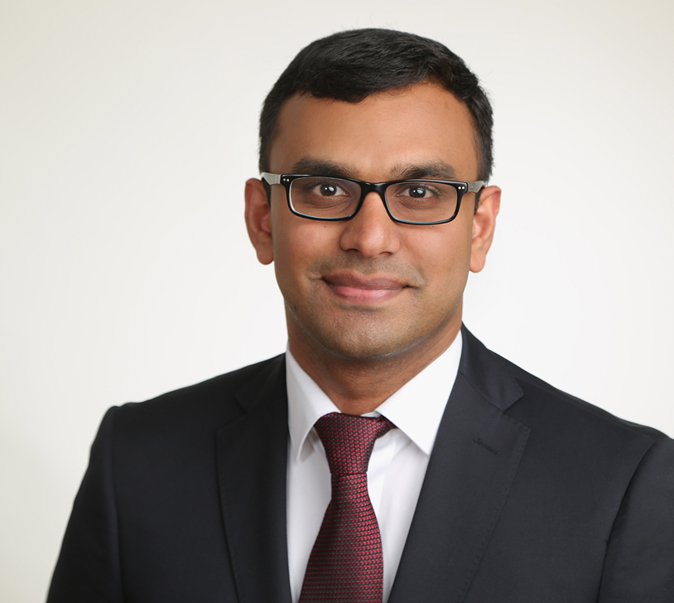
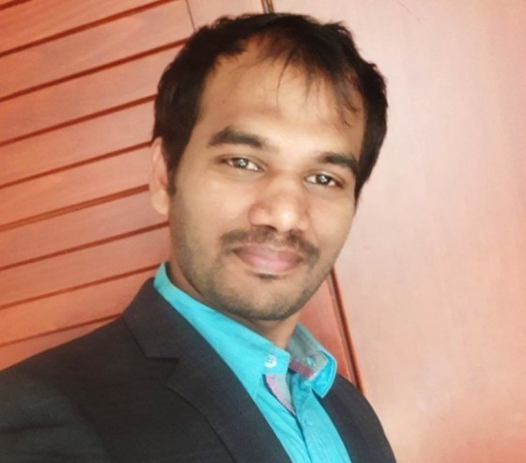
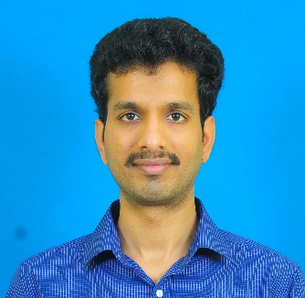
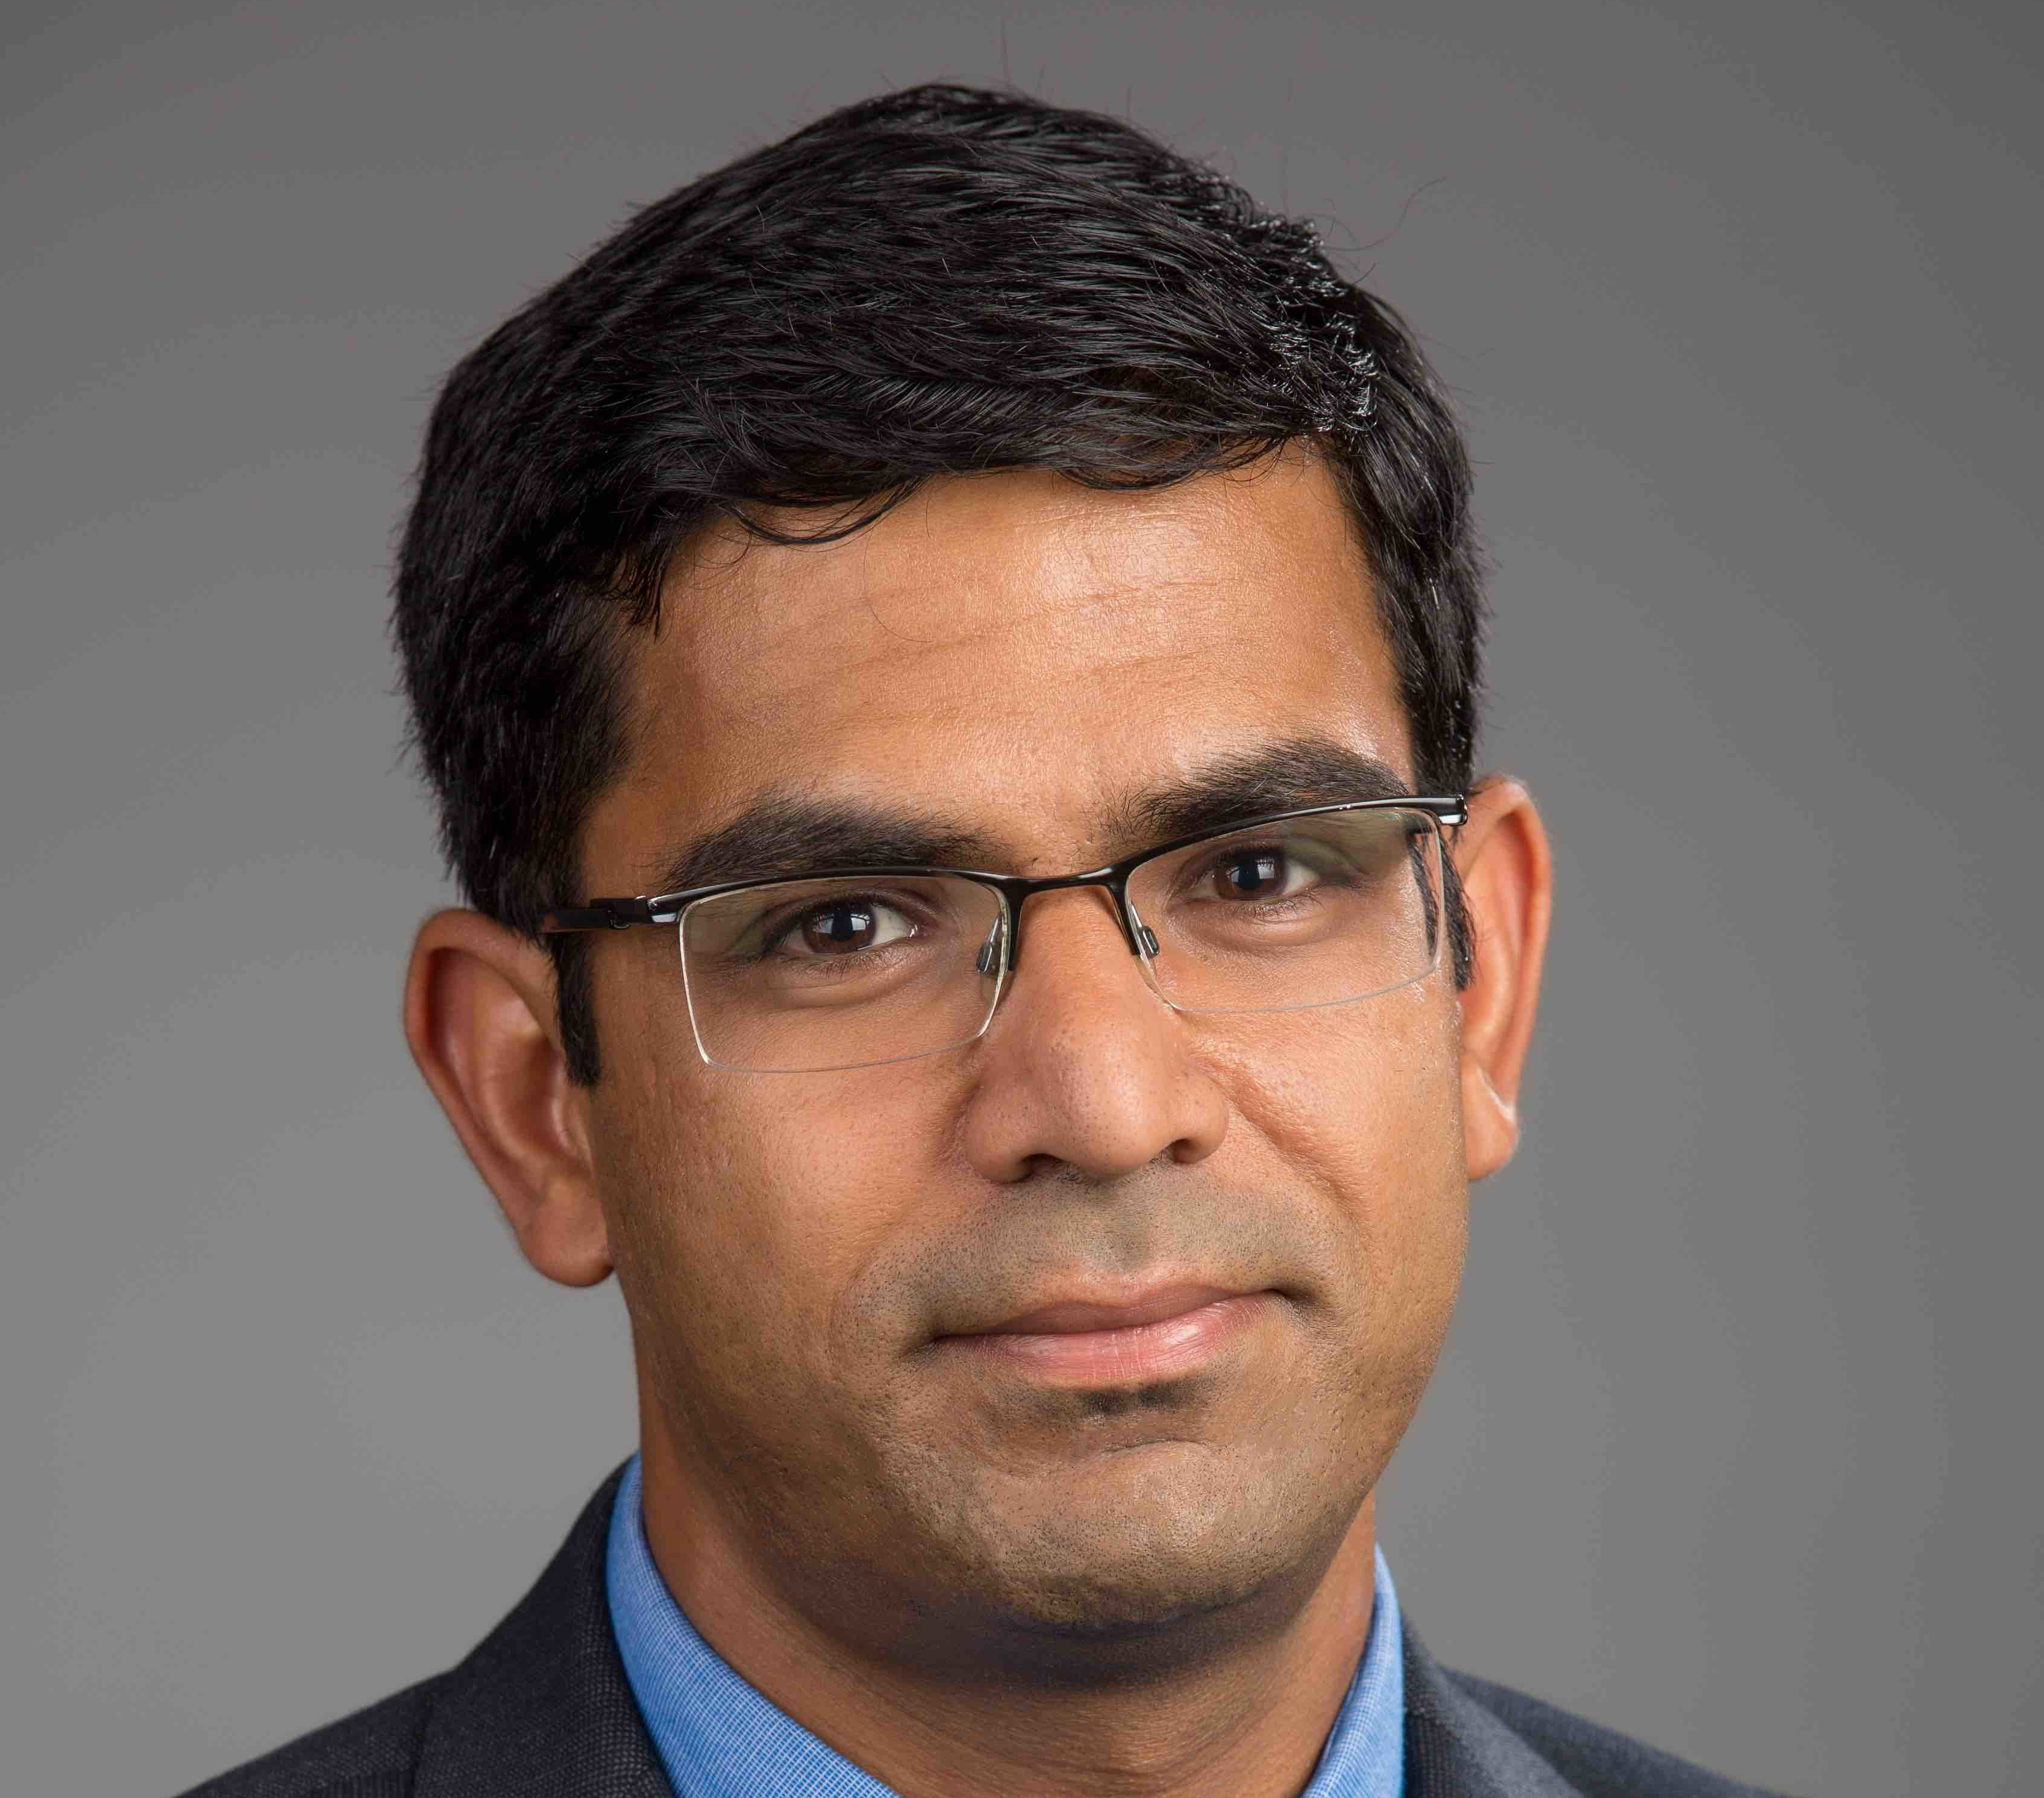
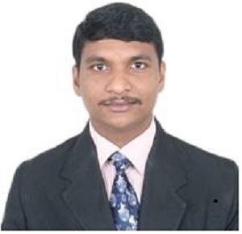
MSME Faculty
Dr. Deepu J. Babu
Nanoporous materials CVD, Adsorption and Membrane-based gas separation applications Carbon nanomaterials, MOFs Graphene & Graphyne and other 2D materials Defect Engineering, Plasma functionalisation
Dr. Ashok Kamaraj
Process metallurgy Physical modeling of unit processes Iron and steelmaking Life cycle analysis of processes and products Development of alloy steels
deepu.babu@msme.iith.ac.in +91 8289995143
Dr. Suresh Kumar Garlapati
ashokk@msme.iith.ac.in +91 (40) 2301 6566
Printed electronics (transistors and CMOS logics) Oxide Semiconductors Electrolytes Organic electronics (transistors and chemiresistors) Gas sensors Memristors
Dr. Anuj Goyal
Computational Material Science Multiscale modeling Electronic structure theory Defects thermodynamics, Point defects Dislocations and interfaces Metals and semiconductors (oxides, nitrides, chalcogenides, halides).
gsuresh@msme.iith.ac.in +91 9100930553
Dr. Suresh Perumal
anujgoyal@msme.iith.ac.in +91 (40) 2301 6567
Thermoelectric Materials, Metrology and Devices Magnetic Refrigeration Energy Storage devices Powder Metallurgy
suresh@msme.iith.ac.in +917022565805

Slide 9
Proposed Ph.D. topics (MOE seats: not an exhaustive list)
Welding and Additive Manufacturing
Powder Metallurgy & Sintering Mechanisms, Metal Additive Manufacturing, Nanostructures, High Entropy Alloys, MAX Phases and MXene, Advanced ceramics & composites, High temperature materials, Biomaterials, Microstructure-Mechanical Properties of Steels, Surface modification by Electro-Spark Deposition, Wear & Tribology
Electrochemical Materials Processing (Green Hydrogen production, reduction of CO₂ & N₂, Electrochemical/Microbial Recovery & Recycling of e-wastes (end of life NdBFe permanent magnets, spent Lithium-ion batteries, Silicon PVs) via electrowinning, Electrochemical Iron & Steel Manufacturing, Molten salt electrolysis for new age applications); Advanced Multi-Functional Nanostructured Materials/High Entropy Alloys making via Electrodeposition: Combinatorial Alloy Design
Nanostructured carbon materials for Li-ion batteries and supercapacitors; Synthesis of novel multicomponent oxide (high entropy oxide) and high entropy alloy nanoparticles; Biomimetic approaches for superhydrophobic surfaces and coatings
Nanoplasmonics and nano photonics, Alternative nanofabrication techniques and chemical synthesis, Optical sensors and modulators, Nanophotonic opto-electronic devices

Slide 10
Proposed Ph.D. topics (MOE seats: not an exhaustive list)
Phase Transformations and Microstructure Development, Laser and Electron Beam Processing, Welding and Surface Treatment, Modelling and Simulation (Phase Field/FEM/CVM)
Mechanical Behavior of Materials both at room temperature as well as at high temperature, creep and superplasticity, micro mechanical deformation, molecular dynamic simulations, nano indentation, light weight alloys.
In situ Transmission Electron Microscopy, In situ characterization and technique development using MEMS devices (lab on chip), Phase transformations in materials, Electrochemsitry and Corrosion, Graphene based super capacitors, Materials for Energy Applications
Spintronic based memory and logic devices, Nanomagnetic materials,Domain wall dynamics in ferromagnetic networks,Spin torque nano-oscillators for RF applications, Spin-orbit torque induced magnetization switching and dynamics,Magnetic tunnel junctions, Micro and Nanofabrication techniques
Semiconductor materials and devices, printed and flexible electronics, oxide semiconductors, electrolyte gating, organic electronics, gas sensors, and memristors
Nanoporous materials, Adsorption, Membranes, Active separations, Defect engineering, Carbon nanomaterials, Metal-organic frameworks, Plasma functionalization, Phase inversion, Chemical vapor deposition, Nanofluidics.

Slide 11
Proposed Ph.D. topics (MOE seats: not an exhaustive list)
Process Modeling & Simulation; Extraction & Molten Metal Treatment; Continuous Casting, Inclusion Engineering & alloy steel development; Hot-slag engineering, Metal Recycling & Life Cycle Analysis of Metallurgical Processes
Computational multiscale modeling of metals and alloys, First principles modeling of defects in semiconductors (oxides, nitrides, chalcogenides). Computational materials design for functional (microelectronics, quantum technologies) and structural (superalloys) applications
Thermoelectric Materials and Devices, Magnetic Refrigeration, Thermoelectric Metrology, and Powder Metallurgy

Slide 12
Eligibility & Qualifications
Candidates interested in Institute scholarship (MoE) and Candidates with external funding (DST-Inspire/ joint CSIR-UGC JRF QUALIFIED/ industry sponsorship/ external registrants from national research laboratories) with the required qualifications (mentioned below) are encouraged to apply. Externally funded candidates (non-MoE) are encouraged to contact interested MSME faculty before the exam/ interview schedule. Also, a few seats are separately available under Direct-Ph.D. admission of CFI students in the MSME department. The details with criteria are mentioned in the IITH admission portal.
Candidate should have one of the following qualifications:
M.Tech./M.E. or equivalent degree (with a minimum first-class) in Materials Science and Engineering, Metallurgical Engineering, Ceramics, Mechanical Engineering, Manufacturing/ Production Engineering, Nanoscience, Polymer, Biomaterial, Chemical Engineering and other relevant areas. OR
Direct Ph.D. - B.Tech. / B.E. in the above disciplines with a CGPA of 8.0 (Gen) and 7.5 (for all others) and a valid GATE score. The GATE criterion is not mandatory for B.Tech. or B.S. students graduating from an IIT/ IISc-B/ NIT /IISER or any CFTI. OR
M.Sc. or equivalent in Materials Science/ Physics/ Chemistry / Biology or equivalent degree with a valid GATE Score in a relevant area or joint CSIR-UGC JRF, DST-INSPIRE, qualified or equivalent exam. OR
Candidates working in industry and R&D Labs with a first-class B.Tech./B.E. or equivalent Degree in a relevant discipline and two years of experience are eligible to apply as an external Ph.D. student. GATE is not mandatory for them. However, they must provide an NOC from their current employer as well as a DSIR certificate.
Please note: - mere fulfillment of the eligibility criteria does not guarantee shortlisting
- only candidates shortlisted for written test and/or interview would be intimated (by email)

